Slide 1
Introduction to Statistical Methods
ISM Team

Slide 2
Session 1:
Overview of the course
& Descriptive Statistics
(Session 1: 7th /8th May 2022)

Slide 3
Overview of the course
TEXT BOOK
Probability and Statistics for Engineering and Sciences,
8th Edition, Jay L Devore, Cengage Learning

Slide 4
Overview of the course
Descriptive Statistics
Probability
Conditional Probability
Random Variables
Probability Distributions – Univariate & Joint
Sampling & Estimation
Testing of Hypothesis – mean , proportions
Regression
Time Series Analysis

Slide 5
Contact Session | List of Topic Title | Reference
CS - 1 | Descriptive Statistics: Data Visualisation, Measures of Central Tendency, Measures of Variability | T1:Chapter 1

Slide 6
Evaluation Components
Quiz 1 – 5%
Quiz 2 - 5%
Assignment 1– 7%
Assignment 2 – 8%
Mid – 30%
Compre – 45%
Assignment submission is individual

Slide 7
“Statistical thinking will be one day as necessary for efficient citizenship as the ability to read and write”
H G Wells

Slide 8
!!!!
A famous statistician would never travel by airplane, because she had studied air travel and estimated the probability of there being a bomb on any given flight was 1 in a million, and she was not prepared to accept these odds.
One day a colleague met her at a conference far from home.
"How did you get here, by train?"
"No, I flew"
"What about the possibility of a bomb?"
"Well, I began thinking that if the odds of one bomb are 1:million, then the odds of TWO bombs are (1/1,000,000) x (1/1,000,000) = 10⁻¹². This is a very, very small probability, which I can accept. So, now I bring my own bomb along!"

Slide 9
Statistics may be defined as science that is employed to
Collect the data
Present and organize the data in a systematic manner
Analyse the data
Infer about the data
Take decision from the data.
Statistics may be defined as numerical data with a view to analyse it.

Slide 10
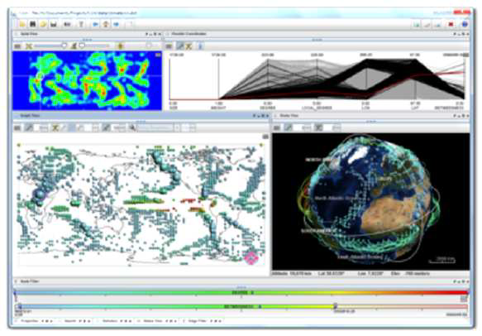
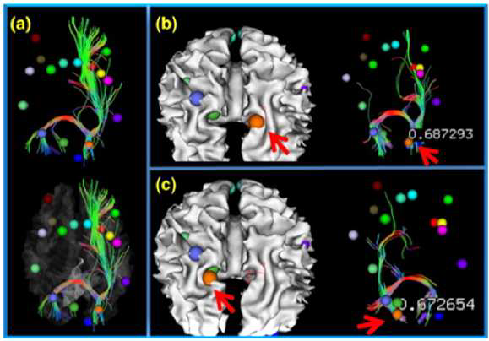
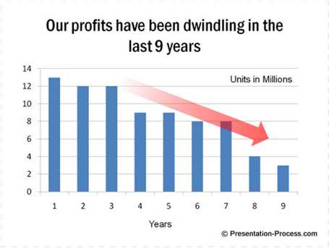
Need for Data Visualization
Tool to enable a user get insight into data
Broadly three types of goals:
• To explore:
Nothing is known
Required to get an insight
To analyze :
There are hypotheses
Used for verification or falsification
To present:
We have the required information
Used for communication of result
Source: Google images

Slide 11
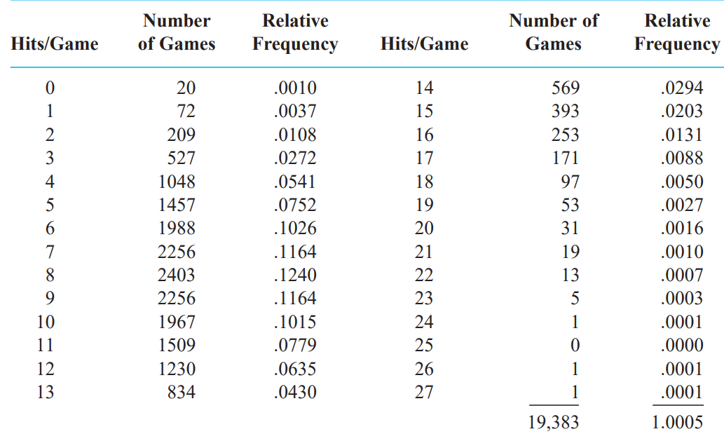

Slide 12
Statistical Visualization
A picture is worth a thousand words!
Bar chart / graph
Histogram
Box plot
Pie chart
Density plot
Line chart
Frequency polygons
Scatter plots

Slide 13
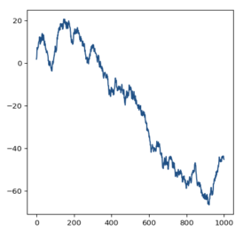
Chart Types
Line charts are great when it comes to displaying patterns of change across a continuum.

Slide 14
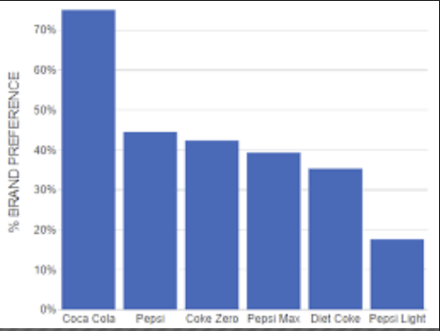
Chart Types
Choose bar charts if you want to compare items in the same category.
The objective is not just to compare but also show how much one is better or worse than the rest.

Slide 15
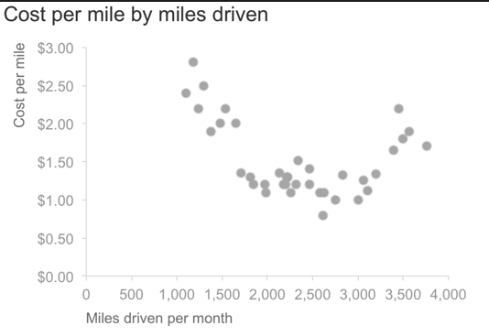
scatterplots.

Slide 16
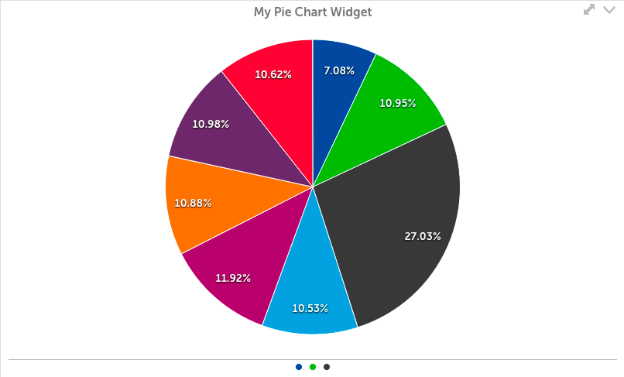
Pie Chart

Slide 17
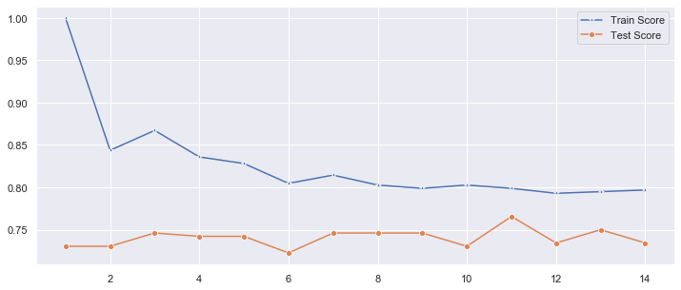

Slide 18
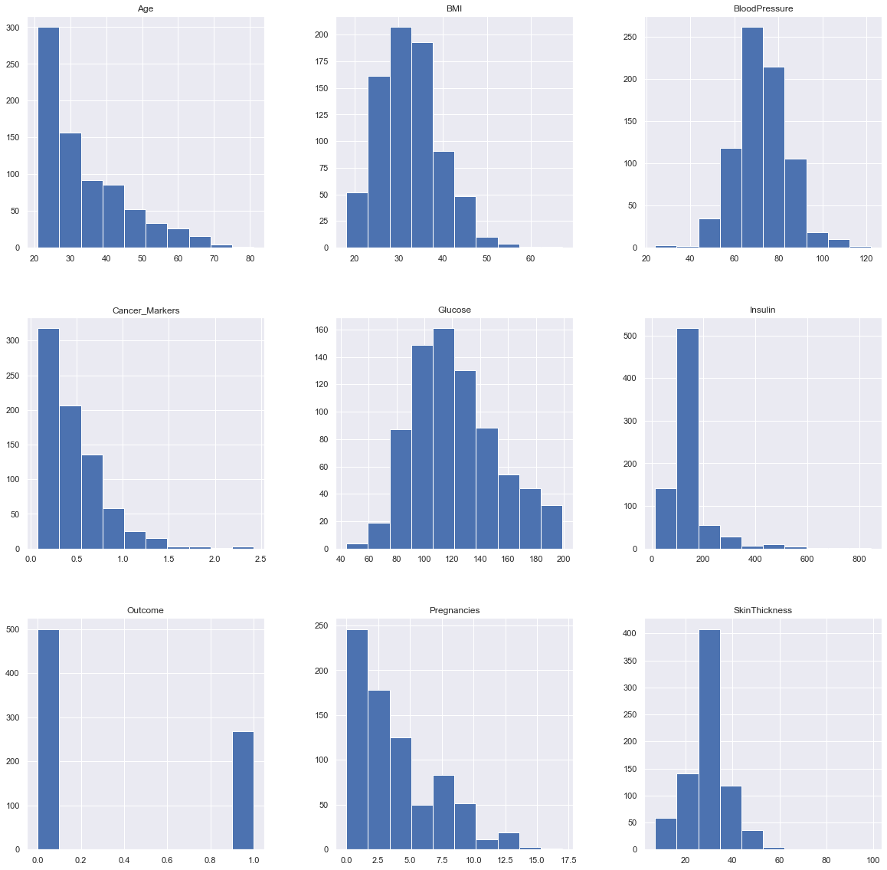

Slide 19
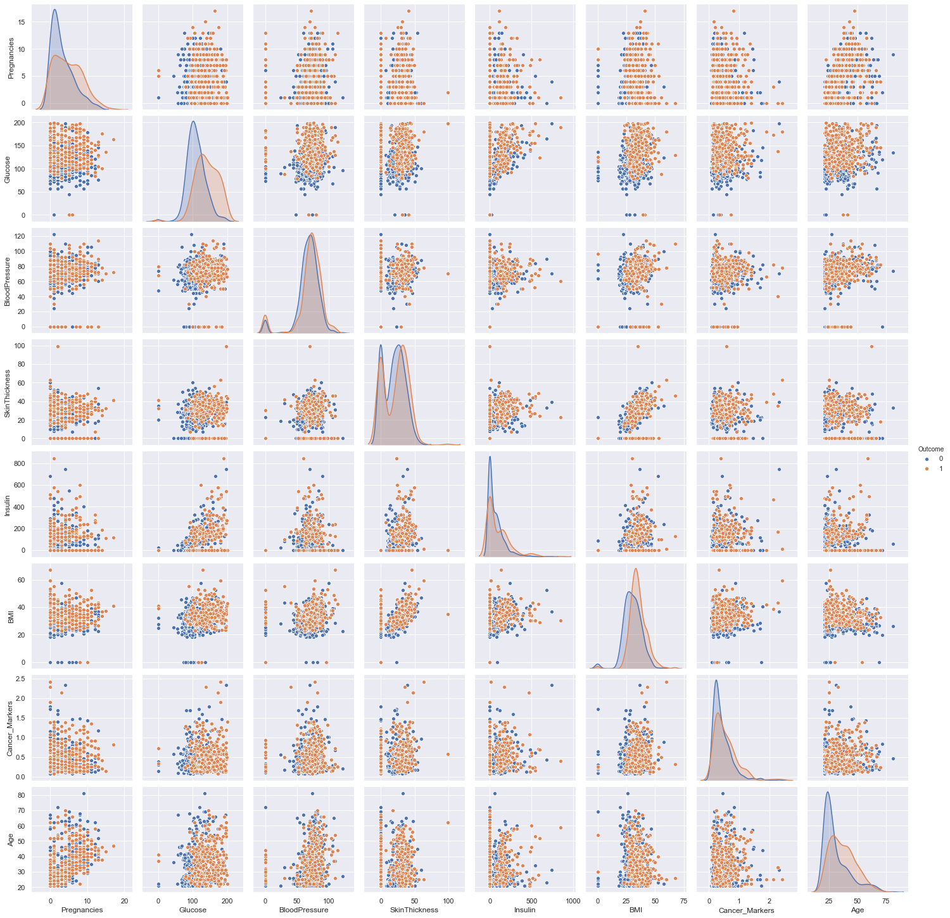

Slide 20
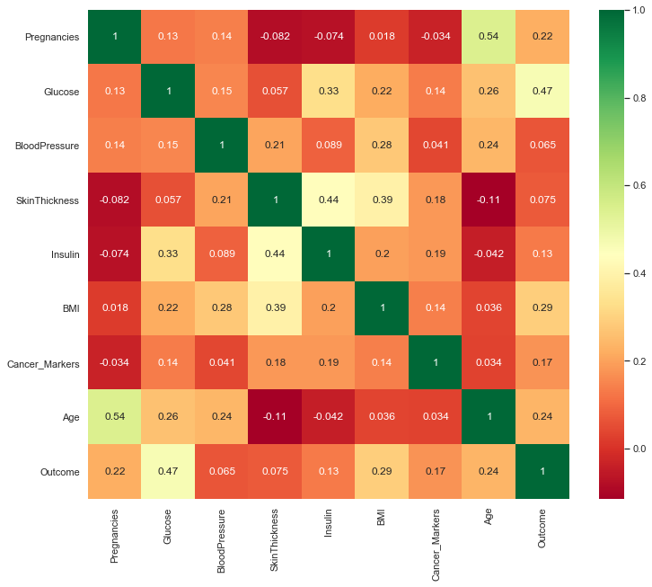

Slide 21
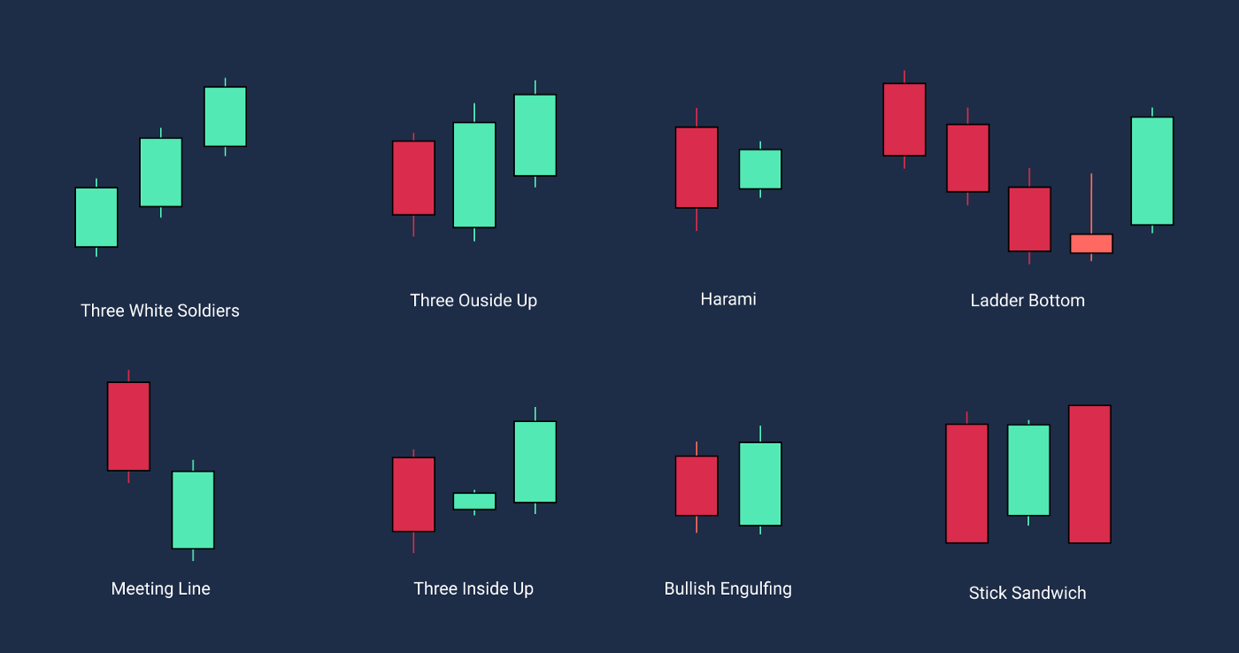

Slide 22
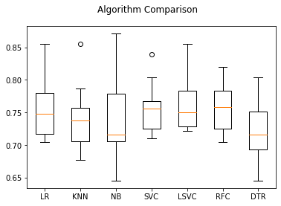

Slide 23
Statistical Summary
Cost | Weight | Weight1 | Length | Height | Width
count | 159.000000 | 159.000000 | 159.000000 | 159.000000 | 159.000000 | 159.000000
mean | 398.326415 | 26.247170 | 28.415723 | 31.227044 | 8.970994 | 4.417486
std | 357.978317 | 9.996441 | 10.716328 | 11.610246 | 4.286208 | 1.685804
min | 0.000000 | 7.500000 | 8.400000 | 8.800000 | 1.728400 | 1.047600
25% | 120.000000 | 19.050000 | 21.000000 | 23.150000 | 5.944800 | 3.385650
50% | 273.000000 | 25.200000 | 27.300000 | 29.400000 | 7.786000 | 4.248500
75% | 650.000000 | 32.700000 | 35.500000 | 39.650000 | 12.365900 | 5.584500
max | 1650.000000 | 59.000000 | 63.400000 | 68.000000 | 18.957000 | 8.142000

Slide 24
Measures of Central Tendency
Measures of Variability

Slide 25

Measures of Central Tendency
Measure of central tendency provides a very convenient way of describing a set of scores with a single number that describes the PERFORMANCE of the group.
Also defined as a single value that is used to describe the “center” of the data.
Three commonly used measures of central tendency:
Mean
Median
Mode

Slide 26
Mean
Also referred as the “arithmetic average”
The most commonly used measure of the center of data
Numbers that describe what is average or typical of the distribution
Computation of Sample Mean:
= Σ Y/ N = (Y1 + Y2 + Y3 + … Yn) / N where
“Y bar” equals the sum of all the scores, Y, divided by the number of scores, N.
Computation of the Mean for grouped Data
Where f Y = a score multiplied by its frequency

Slide 27
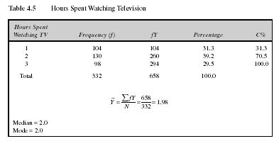
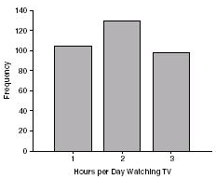
Mean: Grouped Scores
Data of Children watching TV in Bengaluru

Slide 28
Mean
Properties
It measures stability. Mean is the most stable among other measures of central tendency because every score contributes to the value of the mean.
It may easily affected by the extreme scores.
The sum of each score’s distance from the mean is zero.
It can be applied to interval level of measurement
It may not be an actual score in the distribution
It is very easy to compute.

Slide 29
Mean
When to Use the Mean
Sampling stability is desired.
Other measures are to be computed such as standard deviation, coefficient of variation and skewness

Slide 30
The Mode
The category or score with the largest frequency (or percentage) in the distribution.
The mode can be calculated for variables with levels of measurement that are: nominal, ordinal, or interval-ratio.
Example:
Number of Votes for Candidates for Lok Sabha MP. The mode, in this case, gives you the “central” response of the voters: the most popular candidate.
Candidate A – 11,769 votes The Mode:
Candidate B – 39,443 votes “Candidate C”
Candidate C – 78,331 votes
Notes:
For a nominal variable, the mode is the only measure that can be used.
For ordinal variables, the mode and the median may be used. The median provides more information (taking into account the ranking of categories.)
For interval-ratio variables, the mode, median, and mean may all be calculated. The mean provides the most information about the distribution, but the median is preferred if the distribution is skewed.

Slide 31
Mode
Properties
It can be used when the data are qualitative as well as quantitative.
It may not be unique.
It is affected by extreme values.
It may not exist.
When to Use the Median
When the “typical” value is desired.
When the data set is measured on a nominal scale

Slide 32
The Median
The score that divides the distribution into two equal parts, so that half the cases are above it and half below it.
The median is the middle score, or average of middle scores in a distribution.
Fifty percent (50%) lies below the median value and 50% lies above the median value.
It is also known as the middle score or the 50th percentile.

Slide 33



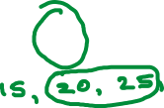
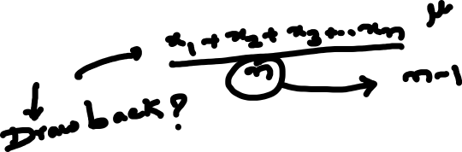
Measures of central tendency
The mean
the median
the mode

Slide 34
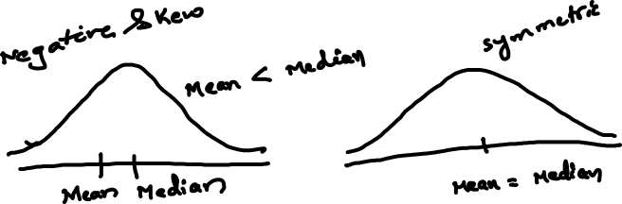
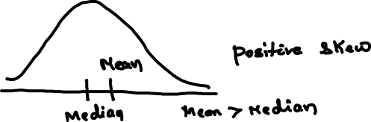

Slide 35
Shape of the Distribution
Symmetrical : mean is about equal to median
Skewed
Negatively : mean < median
Positively : mean > median
Bimodal : has two distinct modes
Multi-modal : has more than 2 distinct modes)
Notes:
Draw Examples on the board

Slide 36
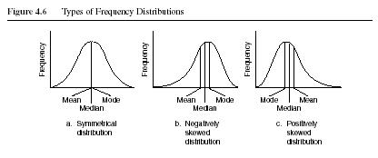
Distribution Shape

Slide 37
Sl. No. | X₁
1 | 2
2 | 8
3 | 5
4 | 3
5 | 7
6 | 8
7 | 5
8 | 2
9 | 5
Total | 45
X₂
1
15
5
5
6
3
5
2
3
45

Slide 38
Sl. No. | X₁
1 | 2
2 | 8
3 | 5
4 | 3
5 | 7
6 | 8
7 | 5
8 | 2
9 | 5
Total | 45
Statistical measures | Group 1
Mean | 5
Median | 5
Mode | 5

Slide 39
Sl. No. | X₂
1 | 1
2 | 15
3 | 5
4 | 5
5 | 6
6 | 3
7 | 5
8 | 2
9 | 3
Total | 45
Statistical measures | Group 2
Mean | 5
Median | 5
Mode | 5

Slide 40
Sl. No. | X₁
1 | 2
2 | 8
3 | 5
4 | 3
5 | 7
6 | 8
7 | 5
8 | 2
9 | 5
Total | 45
X₂
1
15
5
5
6
3
5
2
3
45
Statistical measures | Group 1 & 2
Mean | 5
Median | 5
Mode | 5

Slide 41


Slide 42
Do we need any other measure?
Answer: Yes
Measures of variability
Three Measures of Variability:
The Range
The Variance
The Standard Deviations

Slide 43
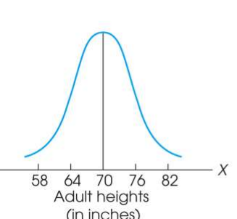
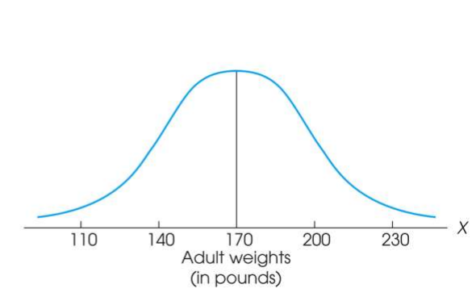
Measure of Variability
Variability can be defined several ways:
A quantitative distance measure based on the differences between scores
Describes distance of the spread of scores or distance of a score from the mean
Purposes of Measure of Variability:
Describe the distribution
Measure how well an individual score represents the distribution

Slide 44
The Three Measures
Three Measures of Variability:
The Range
The Variance
The Standard Deviations

Slide 45
The Ranges
The distance covered by the scores in a distribution – From smallest value to highest value
For continuous data, real limits are used
Based on two scores, not all the data – An imprecise, unreliable measure of variability
Range = URL for X_{max} - LRL for X_{min}
Example: For a set of scores: 7, 2, 7, 6, 5, 6, 2
Range = Highest Score minus Lowest score = 7 - 2 = 5

Slide 46
The Standard Deviation
Most common and most important measure of variability is the standard deviation
A measure of the standard, or average, distance from the mean
Describes whether the scores are clustered closely around the mean or are widely scattered
Calculation differs for population and samples
Variance is a necessary companion concept to standard deviation but not the same concept

Slide 47
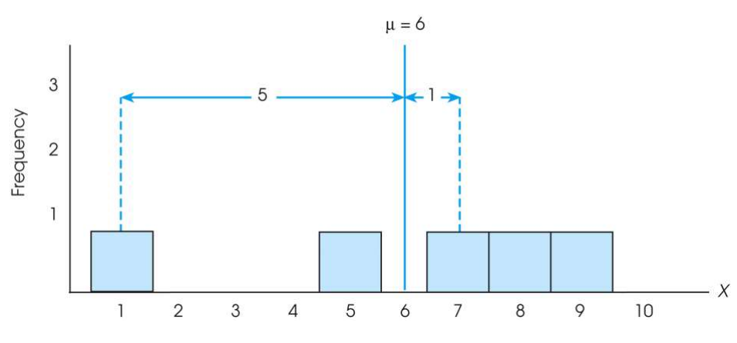

The Standard Deviation
Exercise : Find out the deviations of all the data points with the mean….and then find the ‘mean deviation’.

Slide 48

The Standard Deviation
Mean deviations will always be ‘zero’ !
(because Mean is a balance point)
Then, how do you find ‘Standard Deviation’ ?
Need a new strategy

Slide 49

The Standard Deviation
New Strategy :
First square each deviation score
Then sum the Squared Deviations (SS)
Average the squared deviations
Mean Squared Deviation is known as “Variance”
Variability is now measured in squared units

Slide 50
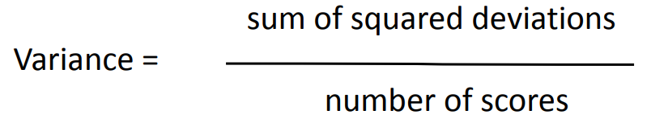
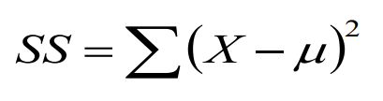
The Variance
Variance equals mean (average) squared deviation (distance) of the scores from the mean
where

Slide 51
The Population Variance
Population variance equals mean (average) squared deviation (distance) of the scores from the population mean
Variance is the average of squared deviations, so we identify population variance with a lowercase Greek letter sigma squared: σ 2
Standard deviation is the square root of the variance, so we identify it with a lowercase Greek letter sigma: σ

Slide 52
Sl. No. | X₁
1 | 2
2 | 8
3 | 5
4 | 3
5 | 7
6 | 8
7 | 5
8 | 2
9 | 5
Total | 45
Statistical measures | Group 1
Mean | 5
Median | 5
Mode | 5

Slide 53
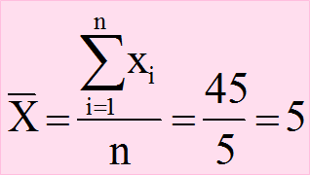
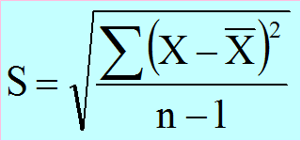
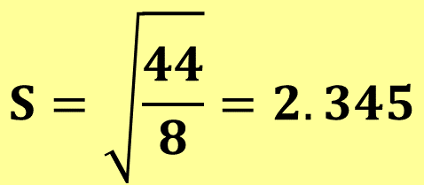
Sl. No. | X₁
1 | 2
2 | 8
3 | 5
4 | 3
5 | 7
6 | 8
7 | 5
8 | 2
9 | 5
Total | 45
$$S=\sqrt{\frac{44}{8}}=2.345$$

Slide 54
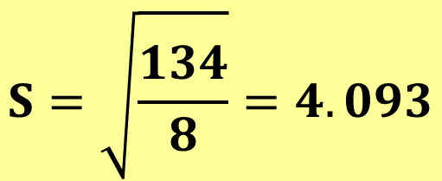
Sl. No. | X₂
1 | 1
2 | 15
3 | 5
4 | 5
5 | 6
6 | 3
7 | 5
8 | 2
9 | 3
Total | 45
$$S=\sqrt{\frac{134}{8}}=4.093$$

Slide 55
Learning Check
If all the scores in a data set are the same, the Standard Deviation is equal to 1.00
The standard deviation measures …
(1) Sum of squared deviation scores
(2) Standard distance of a score from the mean
(3) Average deviation of a score from the mean
(4) Average squared distance of a score from the mean
True / False ?
Select the correct option

Slide 56
Solution
If all the scores in a data set are the same, they are equal to the mean and hence the deviation from mean = 0 therefore, Standard Deviation is equal to zero
The standard deviation measures …
(1) Sum of squared deviation scores
(2) Standard distance of a score from the mean
(3) Average deviation of a score from the mean
(4) Average squared distance of a score from the mean
False

Slide 57
Standard Deviation and Variance for a Sample
Goal of inferential statistics:
Draw general conclusions about population
Based on limited information from a sample
Samples differ from the population
Samples have less variability
Computing the Variance and Standard Deviation in the same way as for a population would give a biased estimate of the population values

Slide 58
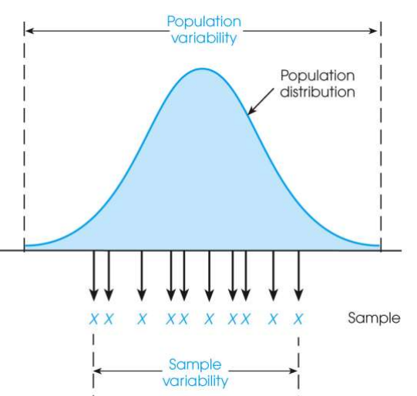
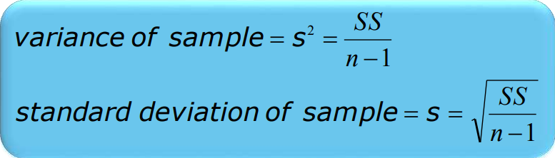
Sample Standard Deviation and Variance
Sum of Squares (SS) is computed as before
Formula for Variance has n-1 rather than N in the denominator
Notation uses s instead of σ
Population of Adult Heights

Slide 59
Degrees of Freedom
Population variance
Mean is known
Deviations are computed from a known mean
Sample variance as estimate of population
Population mean is unknown
Using sample mean restricts variability
Degrees of freedom
Number of scores in sample that are independent and free to vary
Degrees of freedom (df) = n – 1

Slide 60
Learning Check
Select the correct option
A sample of four scores has SS = 24. What is the variance?
The variance is 6
The variance is 7
The variance is 8
The variance is 12
A sample systematically has less variability than a population
The standard deviation is the distance from the Mean to the farthest point on the distribution curve
True / False ?
True / False ?

Slide 61
Solution
Select the correct option
A sample of four scores has SS = 24. What is the variance?
The variance is 6
The variance is 7
The variance is 8
The variance is 12
Extreme scores affect variability, but are less likely to be included in a sample
The standard deviation extends from the mean approximately halfway to the most extreme score
True
False

Slide 62
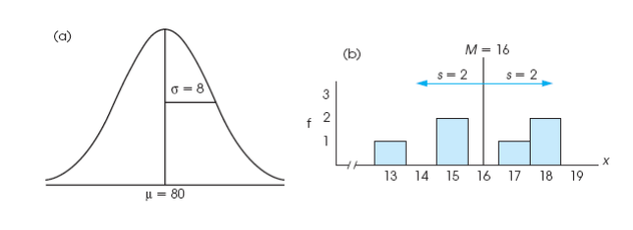
Descriptive Statistics
A standard deviation describes scores in terms of distance from the mean
Describe an entire distribution with just two numbers (M and s)
Reference to both allows reconstruction of the measurement scale from just these two numbers
Means and standard deviations together provide extremely useful descriptive statistics for characterizing distributions

Slide 63
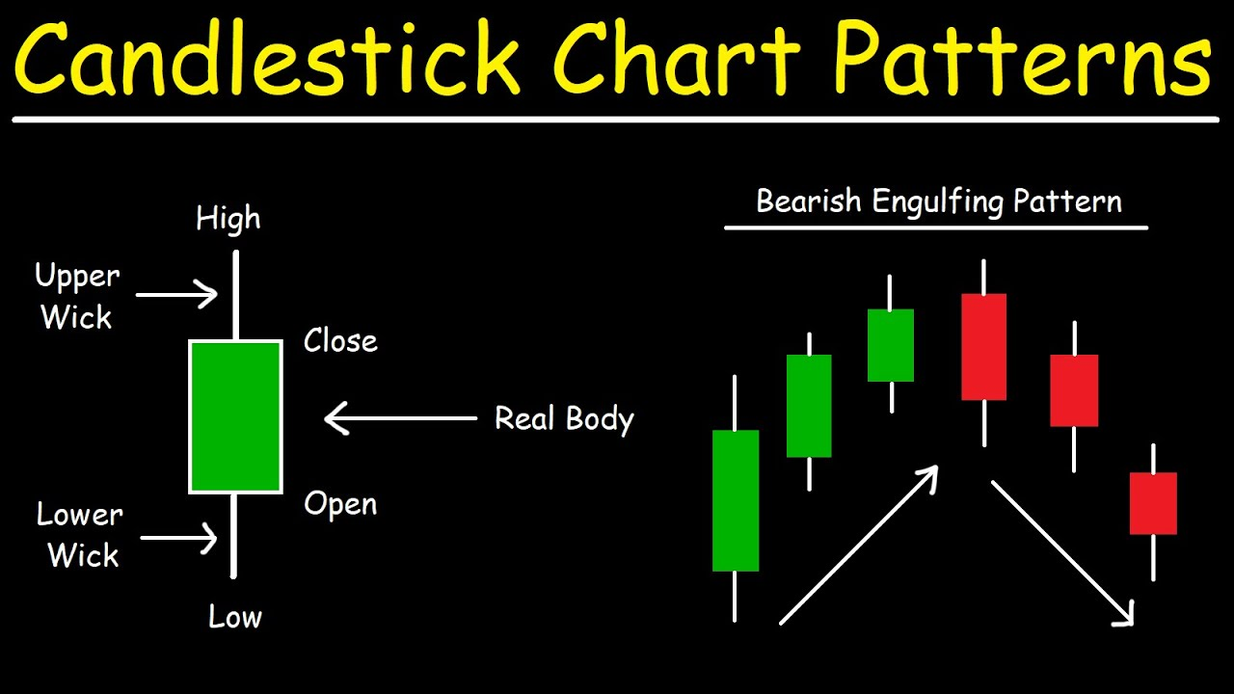

Slide 64
Interquartile range (IQR)
Measure of Variation
Also Known as Midspread: Spread in the Middle 50%
Difference Between Third & First Quartiles:
Not Affected by Extreme Values
Interquartile Range = Q₃ – Q₁
Data in Ordered Array: 11 12 13 16 16 17 17 18 21
1•(9 + 1)
Position of Q₁
=
= 2.50,
Q₁
=12.5
4
3•(9 + 1)
Position of Q₃
=
= 7.50,
Q₃
=17.5
4
Interquartile Range = Q₃ – Q₁ = 17.5 - 12.5 = 5

Slide 65
Box and Whisker plot
97.5th Centile
75th Centile
Q₁
MEDIAN
(50th centile)
Q₂
25th Centile
Q₃
Inter-quartile range
2.5th Centile

Slide 66
Box and Whisker plot
IQR = Q₃ – Q₁
Q₁-1.5 IQR
Q₃+1.5 IQR
Min
Max
Q₁
Q₂
Q₃
Outlier
Outlier

Slide 67
Box-and-Whisker plot
IQR = Q₃ – Q₁
Min
Q₁-1.5 IQR
Q₃+1.5 IQR
Max
Q₁
Q₂
Q₃
Q₃+3 IQR
Q₁-3 IQR
Major Outlier
Major Outlier

Slide 68
Thanks

